Slide 1
ARM NEWTECH
New and certified refurbished
medical equipment.
AI-POWERED SOURCING
You: Need a Siemens 1.5T MRI, not older than 2020.
AI: Options found in seconds — delivery 2–5 months, personal price offer in minutes.
MRI · CT · Ultrasound · X-Ray · Radiotherapy · OEM parts — supply, installation and service for healthcare facilities in 52 countries since 2015.
AI supports your request; professional offers are prepared by engineers with 20+ years of experience.
COMPANY PRESENTATION · 2026
armnewtech.com

Slide 2
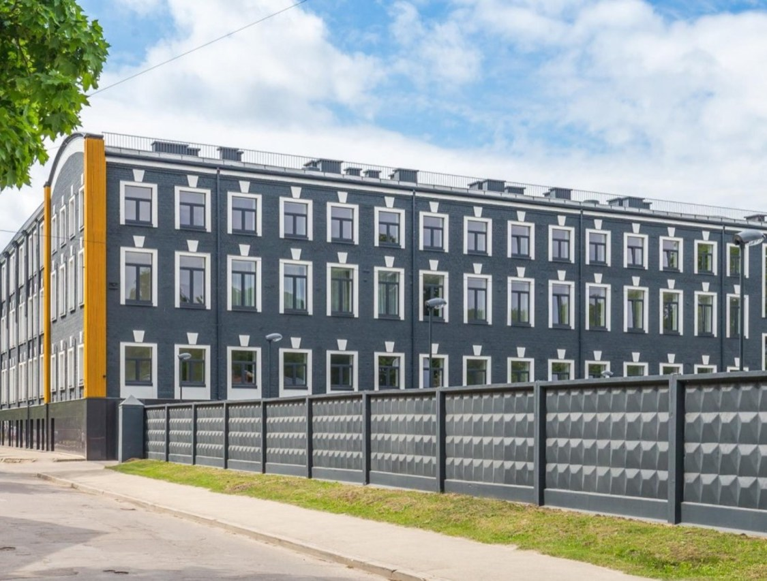
About ArmNewTech
ArmNewTech supplies new and certified refurbished medical equipment to healthcare facilities in 52 countries since 2015. With local partners across Europe and Asia, we support each project end-to-end — supply, logistics, installation, training and service.
Every system is tested and certified to international standards: FDA-approved and/or CE-marked units ship with full documentation. Certified refurbished systems pass a multi-point inspection and carry a 12-month warranty.
EU LEGAL ENTITY
CE / FDA DOCUMENTATION
KYC ON EVERY DEAL
European headquarters — Valentina iela 16, Riga, Latvia
SIA FIT ALLIANCE GROUP · Reg. No 40203698031 — Riga, Latvia. Now launching operations in Eastern Europe through official partners.
ARMNEWTECH · Company Presentation 2026
02

Slide 3
ArmNewTech in numbers
Catalog figures are generated live from the 2026 price list.
2015
52
152
15
on the market since — 10+ years of international supply
countries supplied with medical equipment
models in the 2026 price catalog
equipment categories — from imaging to furniture
30
150,000+
70+
24/7
brands represented in the current catalog
units reachable through the supplier network
manufacturers via OEM and partner ties
technical support — phone, remote and onsite
ARMNEWTECH · Company Presentation 2026
03

Slide 4
Portfolio — diagnostic imaging & oncology
152 models across 15 categories in the 2026 catalog — new and certified refurbished.
39 models
36 models
16 models
10 models
CT
MRI
Ultrasound
X-Ray
4 to 256+ slices, cardiac and dual-energy
1.5T and 3T — closed, wide-bore and open magnets
cart-based, portable and POCUS scanners
DR rooms, mobile DR and fluoroscopy
5 models
5 models
4 models
2 models
C-Arm
LINAC
Angiography
Radiotherapy
surgical C-arms and mini C-arms
Varian and Elekta radiotherapy platforms
cath lab systems, floor and ceiling mounted
SRS and HDR brachytherapy systems
ARMNEWTECH · Company Presentation 2026
04

Slide 5
Portfolio — life support, clinical & parts
Anesthesia and ICU, monitoring, laboratory, furniture — plus OEM spare parts from stock.
13 models
6 models
5 models
5 models
Parts
Medical Furniture
Anesthesia
Ventilator
X-ray tubes, coils, detectors, cold heads
electric beds and ward furniture
workstations with gas analysis
ICU, neonatal and transport
3 models
2 models
1 model
152
Laboratory
Patient Monitoring
Endoscopy
models total in 15 categories — in stock and on request
hematology and biochemistry analyzers
multi-parameter monitors for ICU and OR
HD video towers and flexible scopes
ARMNEWTECH · Company Presentation 2026
05

Slide 6
Brand partners & sourcing network
30 brands in the current catalog · 150,000+ units reachable across 70+ manufacturers.
Philips
GE
Siemens
Siemens Healthineers
GE HealthCare
Canon Medical
Medmark Trade
United Imaging
Canon
Comen
Elekta
SonoScape
DRGEM
Mindray
Sysmex
Varian
Chirana
Draeger
Toshiba
Butterfly
Canon / Varex
Hamilton
Hitachi
Hologic
Maquet (Getinge)
Planmed
Shimadzu
Sternmed
Varex / IAE / Richardson Electronics
Ziehm
Direct OEM ties across Siemens, GE, Philips and Canon — systems, X-ray tubes, coils and detectors. ArmNewTech is an independent supplier; brand names identify the equipment we source and all trademarks remain the property of their owners.
ARMNEWTECH · Company Presentation 2026
06

Slide 7
Services — the full commercial cycle
One contract covers the project from sourcing to first patient — and beyond.
Installation
Service & Maintenance
Refurbishment
Rigging, siting, installation, acceptance testing and software configuration.
Preventive maintenance and post-warranty contracts with guaranteed parts.
Certified multi-point restoration to OEM specifications.
Turnkey Projects
Worldwide Logistics
12-Month Warranty
From room planning and RF shielding to first patient — one contract.
Insured DAP / CIF / EXW shipping, rigging, export and customs paperwork.
Standard on certified refurbished systems; extended coverage available.
Technical Support
Trade-In
Financing
24/7 phone and remote assistance, onsite visits and user training.
Trade in your old equipment towards a purchase — terms agreed per deal.
Leasing, installments, SBLC / LC and milestone-tied payment structures in USD or EUR.
ARMNEWTECH · Company Presentation 2026
07

Slide 8
How we work
From first message to a formal offer — in minutes, not days.
1
2
3
Request
AI consultant collects requirements
Formal quotation
Describe what you need — on the website, in the AI chat, via WhatsApp / Telegram or by e-mail.
Modality, budget, condition and timeline; instant catalog matches. Engineers with 20+ years of experience verify the configuration.
A formal PDF offer: model, condition, price, delivery terms and the 12-month warranty.
Answer within 5 minutes during business hours · Delivery 2–5 months · 12-month standard warranty
ARMNEWTECH · Company Presentation 2026
08

Slide 9
Why ArmNewTech
A regulated EU counterparty with a transparent track record.
10+ years in the market
Direct OEM ties
EU legal entity
International medical equipment trade since 2015 — clinics, diagnostic centers and distributors worldwide.
Sourcing network across Siemens, GE, Philips and Canon — systems, tubes, coils and detectors.
SIA FIT ALLIANCE GROUP, Reg. No 40203698031 — Riga, Latvia. Full compliance, CE / FDA documentation.
KYC on every deal
Flexible payments
Open marketplace profiles
Thorough counterparty checks, transparent bilingual contracts and export documentation.
USD / EUR, escrow schemes and staged payments tied to shipment and commissioning milestones.
eBay · Alibaba · Bimedis · DOTmed · TradeIndia — public ratings and verified reviews.
ARMNEWTECH · Company Presentation 2026
09

Slide 10
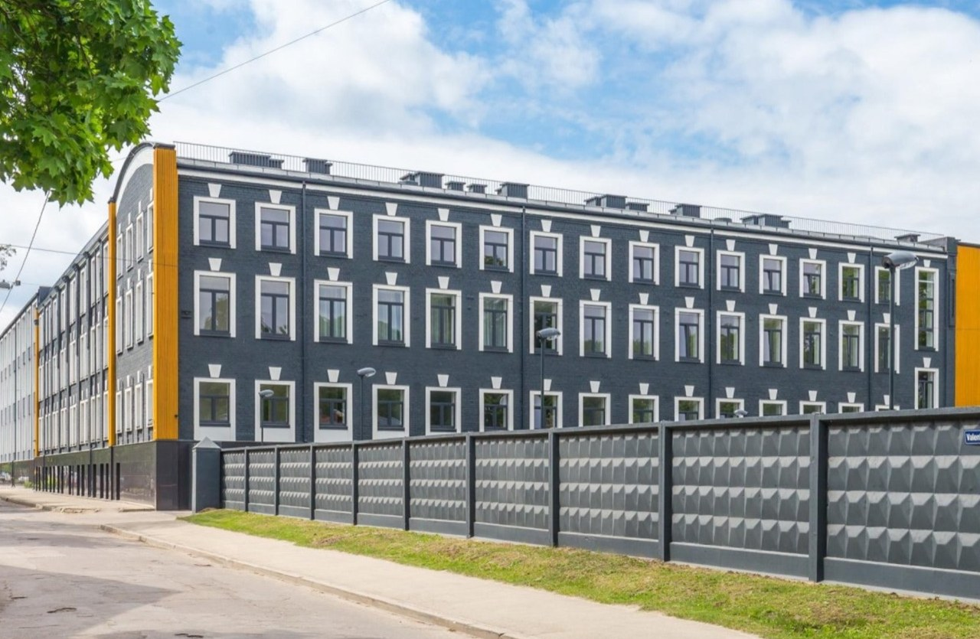

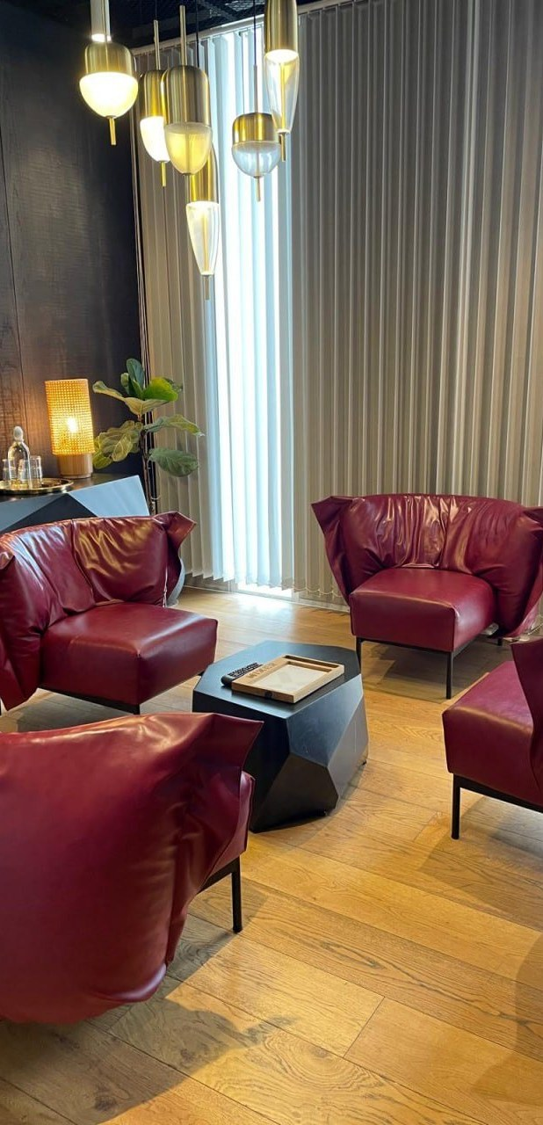

Our offices
European Headquarters — Riga, Latvia
Middle East Office — Herzliya, Israel
Valentina iela 16, Riga, LV-1089 · SIA FIT ALLIANCE GROUP
Arik Einstein 3, Herzliya, 4659071 · sales and partner hub for the Middle East
ARMNEWTECH · Company Presentation 2026
10

Slide 11
ARM NEWTECH
Let's discuss
your project.
E-MAIL
info@armnewtech.com
ORDERS
order@armnewtech.com
Send a request — you will receive a formal offer with price, delivery and warranty terms.
PHONE
+371 28021061
WEB
RIGA · HEADQUARTERS
Valentina iela 16,
Riga, Latvia, LV-1089
HERZLIYA · MIDDLE EAST
Arik Einstein 3,
Herzliya, Israel, 4659071
www.armnewtech.com
WhatsApp · Telegram · 24/7 support
SIA FIT ALLIANCE GROUP · Reg. No 40203698031

